Slide 1
Energy Networks Association
ENA EREC G110 Issue 1 2021
Revision Summary
30th December 2021

Slide 2
ENA EREC G110 Issue 1 2021 Revision Summary
Instantaneous high-impedance differential protection
DOCUMENT PURPOSE
To specify the performance and proving of instantaneous high-impedance differential protective systems as applied to synchronous machines, transformers, reactors, busbars and similar primary plant.
SCOPE
To provide guidance on the performance requirements of high-impedance differential schemes.
To provide guidance for the calculations needed to asses the stability and fault settings of such schemes.
This ENA EREC applies to high-impedance differential schemes for use in the UK Electricity Supply Industry networks.
HISTORY
1st issued as ENA TS 48-3 in 1977
2nd issue in 2013
2021: revised and converted to EREC G110 (issue 1) as detailed overleaf.
2

Slide 3
ENA EREC G110 Issue 1 2021 Revision Summary
Summary of Amendments
Medium revision of a previous Technical Specification (TS 48-3, Issue 2) which has now been converted to an Engineering Recommendation (EREC G110: Issue 1).
References updated where appropriate
Clause 6.1 modified to correct wording error regarding clearance times and stability of the scheme.
Clause 6.3 added to reflect need to consider installing non-linear resistors.
Clauses 7.3 to 7.6 inclusive have been moved to informative Annex B as these schemes incorporate interposing CTs (no longer relevant to modern numerical relays).
Figures 7 to 12 inclusive have been moved to informative Annex B as these are associated with relocated Clauses 7.3 to 7.6.
Some clauses have been rationalised in to one clause as the formulae were identical.
Figure 6a added to show a generic implementation of transformer earth fault protection using a modern numerical relay.
Drawing errors in a number of figures have been corrected.
Table 1 updated and minor errors corrected.
In Annex A1 errors in the formulae for the fault current calculations have been corrected.
Nature of Revision
Medium
Key Points
First Issued in 1977
No major technical changes
Converted to EREC in 2021
3

Slide 4
ENA EREC G110 Issue 1 2021 Revision Summary
Who is affected and why?
ENA Member Company staff, who are primarily tasked with specifying the performance and proving of instantaneous high-impedance differential protective systems as applied to synchronous machines, transformers, reactors, busbars and similar primary plant.
Manufacturers/Suppliers of protection relays that can be used in such schemes.
4

Slide 5
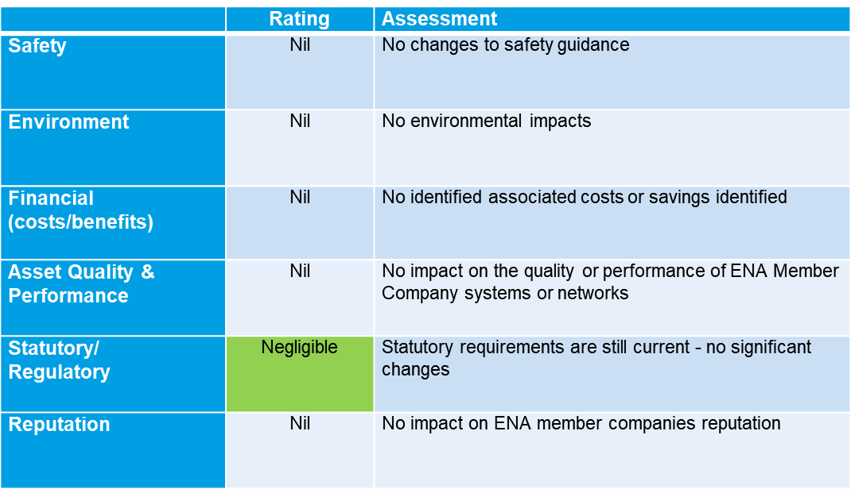
ENA EREC G110 Issue 1 2021 Revision Summary
Impact Assessment
5

Slide 6
© ENA 2020
6

